Slide 1



Verifying Product Carbon Footprints (sine foundation)
SustAInability
Team 2.2: Anastasia Shulman & Aleks Aleksandrov

Slide 2
How can we increase
data quality and transparency
in sustainability initiatives?

Slide 3
Key problems
Greenwashing
Data complexity
Misreporting or manipulating data to present a more positive environmental image
Double accounting by entering mitigating data multiple times
Manipulation of metrics by using non-standardized units or choosing metrics that downplay environmental impact
Massive datasets from various sources, including suppliers, production processes, and distribution channels
Supply chains are intricate networks involving multiple companies and locations
Unstructured data, such as qualitative information from stakeholder reports

Slide 4

How can AI help us tackle these problems?
AI algorithms can process vast amounts of data at unparalleled speeds
Machine learning excels at identifying patterns and anomalies
AI enables real-time data verification, providing instant feedback

Slide 5
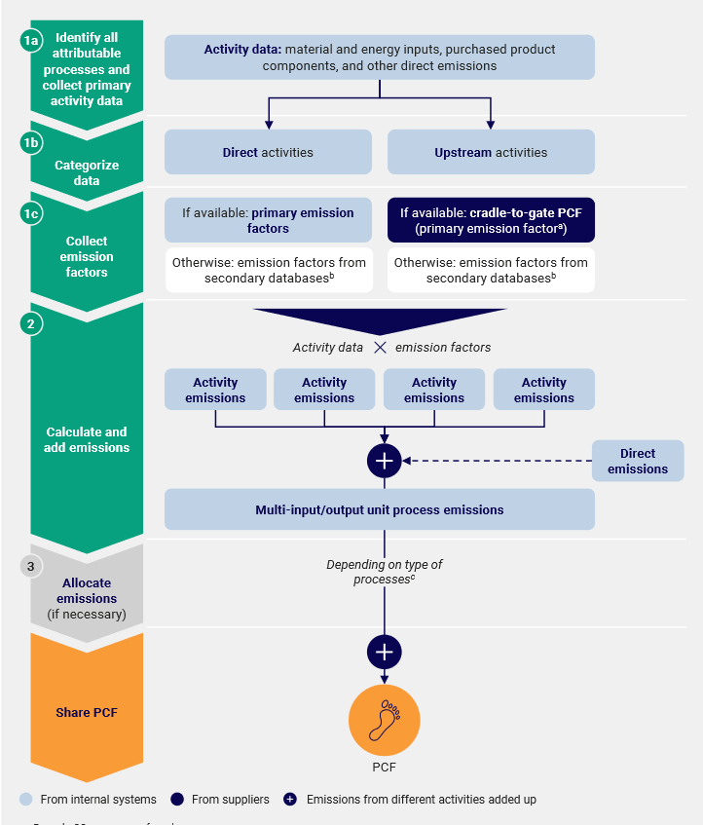
Data
Steps for PCF calculation:
Product Carbon Footprint (PCF):
Total carbon emissions generated by a product over the different stages of its life cycle.
Direct activities: relevant activity data and emissions based on company's own processes
Upstream activities: relevant material and energy input flows from suppliers upstream
Emission factors: representative values that quantify the environmental impact of products and processes
https://www.carbon-transparency.com/media/jpslsujn/pathfinder-framework.pdf

Slide 6
Our solution
Benchmarking: Compare the Product Carbon Footprint of a product against industry standards or similar products
Ranking: Rank products based on their PCF, allowing users to make informed decisions
Comparative Analysis Algorithms

Slide 7
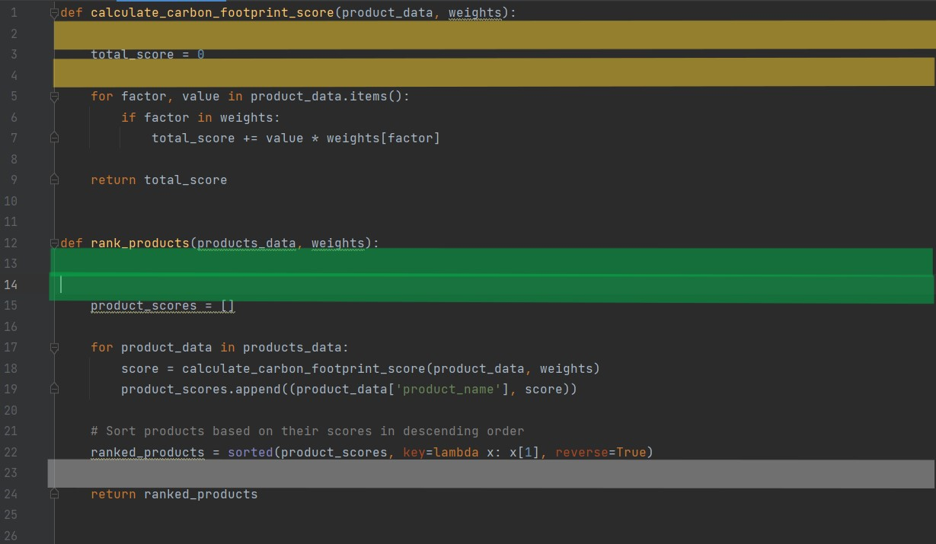
Comparative analysis algorithm example
product_data: Dictionary containing data for the product (e.g., materials, energy inputs, components, manufacturing, transportation)
weights: Dictionary containing weights for different factors affecting the carbon footprint
total_score: overall weighted carbon footprint score for the product

Slide 8

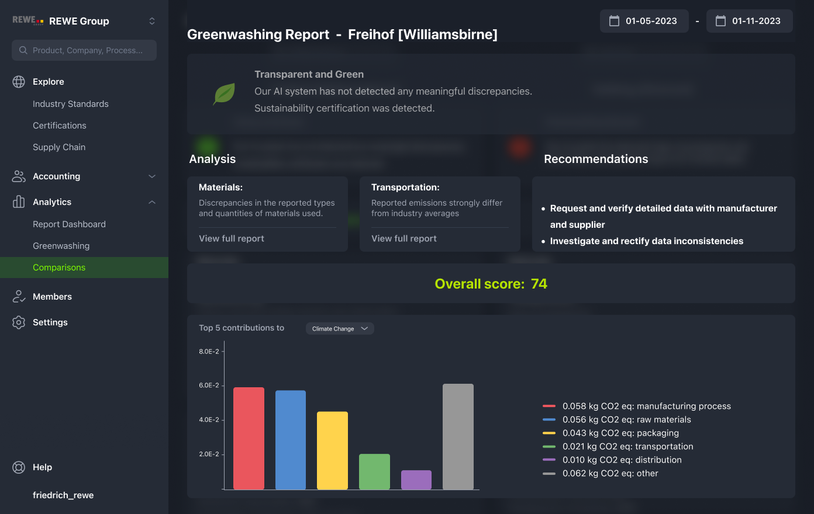
Demonstration

Slide 9
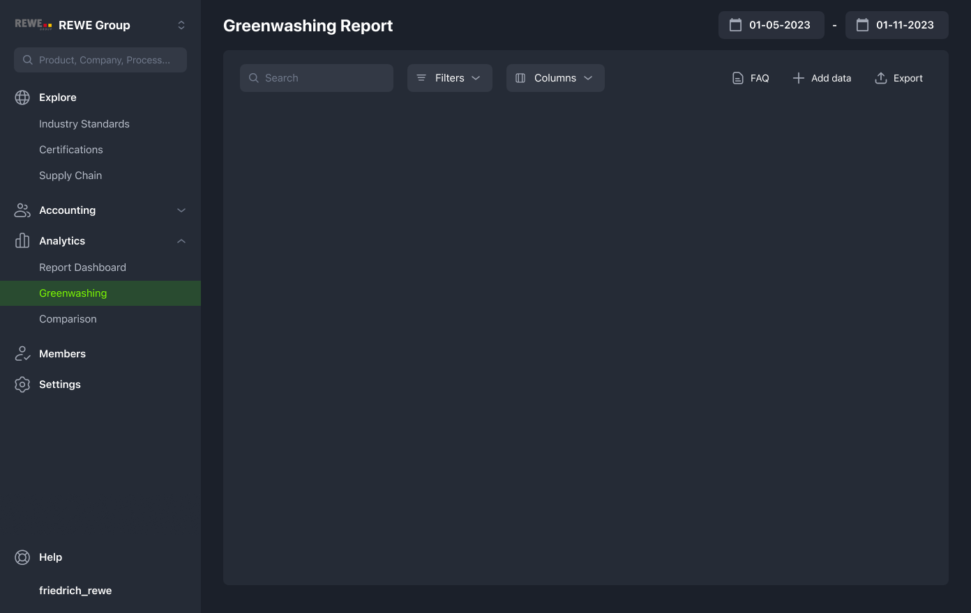


Slide 10
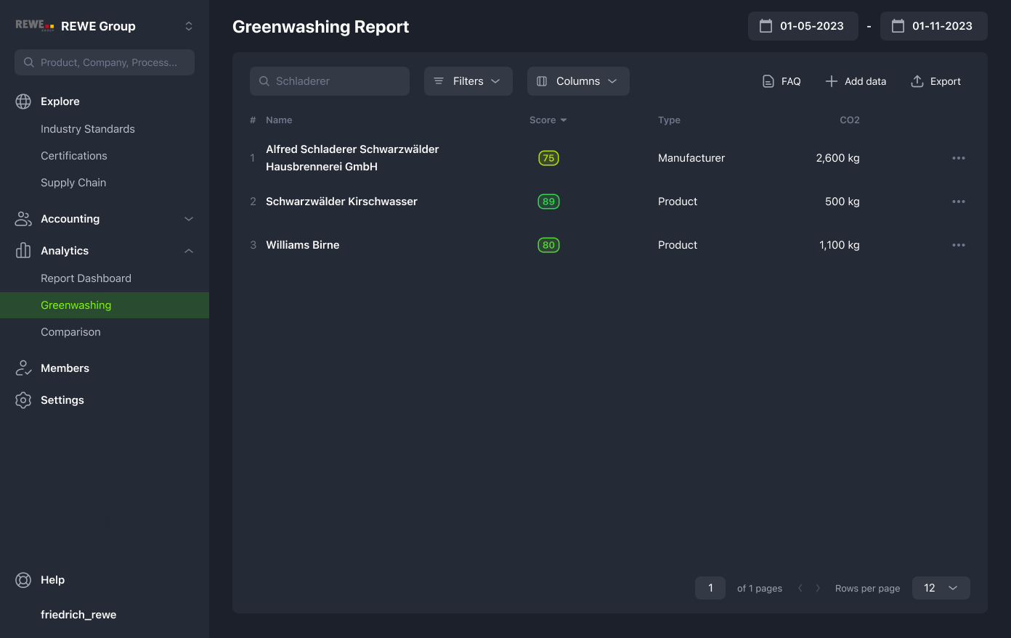

Slide 11
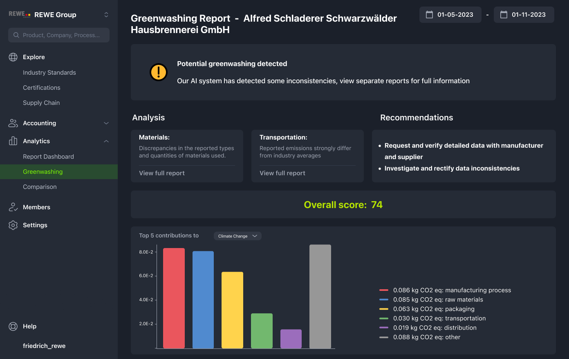

Slide 12
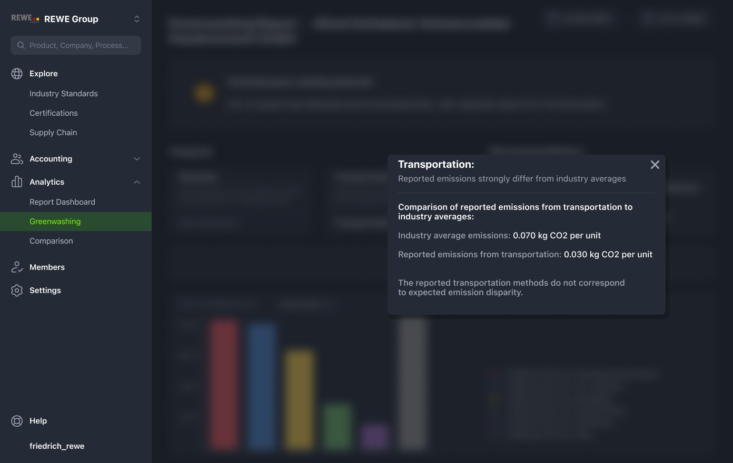

Slide 14
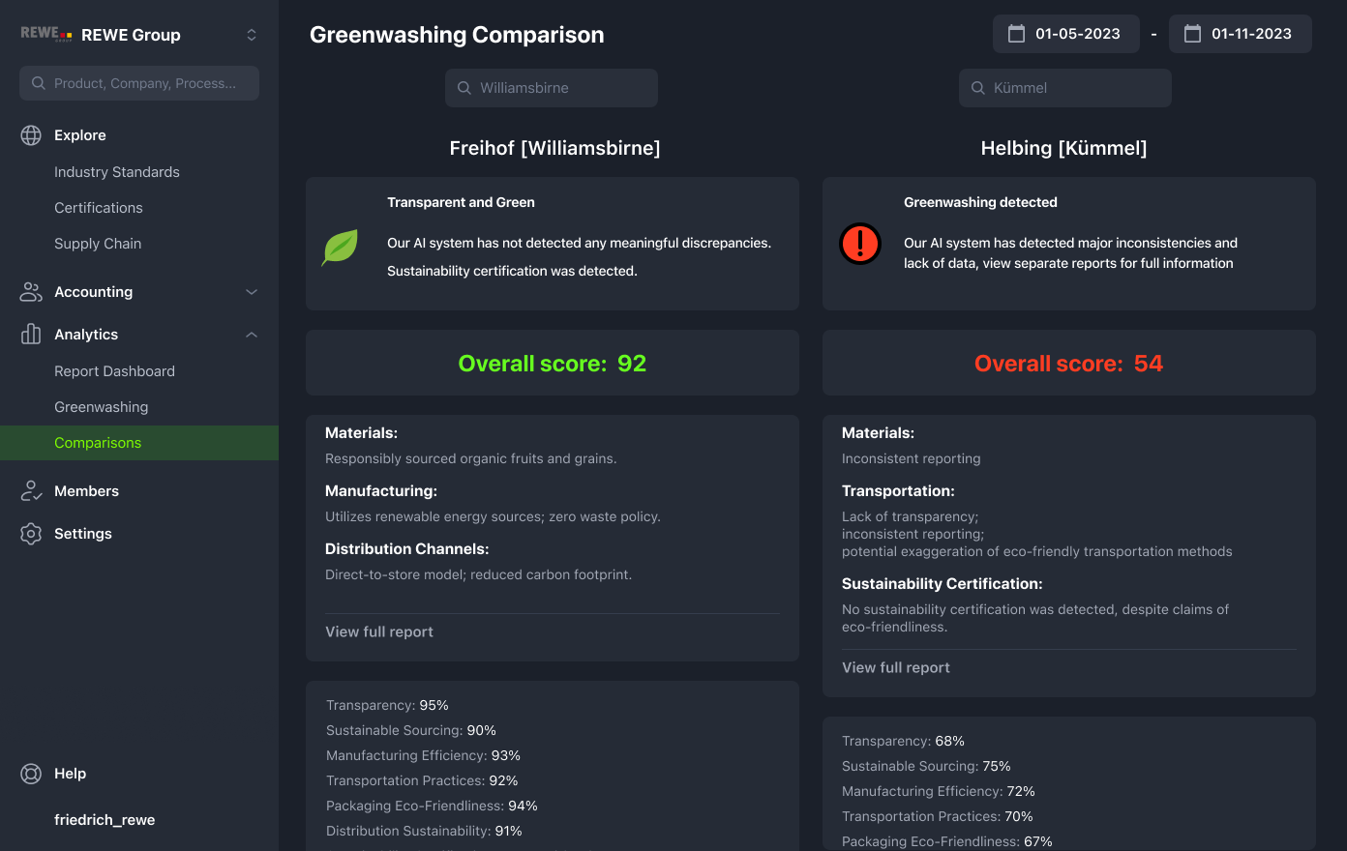

Slide 15
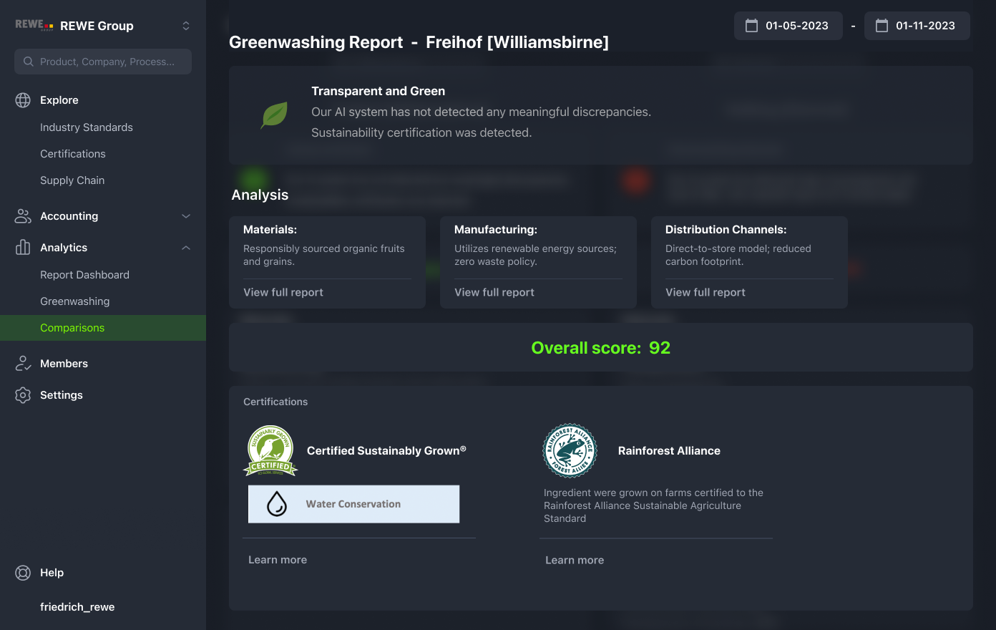

Slide 16
Demonstration

Slide 17
AI Sustainability
AI impact
Greenwashing impact
Large language models such as GPT3 have a CO2 footprint of over 500 tonnes CO2eq
French multinational oil and gas company "Total" greenwashed at least 10 million tonnes of CO2 in 2020
Patterson et al 2021, Luccioni et al. 2022
https://www.clientearth.org/projects/the-greenwashing-files/total/

Slide 18



Thank You For Your Attention!

Slide 19
Quellen
Patterson et al. 2021, S. 6; Luccioni et al. 2022, S. 7
Total. (2022, 18. November). ClientEarth. https://www.clientearth.org/projects/the-greenwashing-files/total/
World Business Council for Sustainable Development. (o. D.). Guidance for the Accounting and Exchange of Product Life Cycle Emissions. Pathfinder Framework, 22. https://www.carbon-transparency.com/media/jpslsujn/pathfinder-framework.pdf

